Slide 1


SPORTS LOCATION SEARCH SYSTEM CSE204: Project-I
Guided By : Asst. Prof. Pinal Hansora
Team Members : Nisarg Patel 23CS070
Tejas Patel 23CS075
Megh Patel 23CS069
Department of Computer Science & Engineering,
Chandubhai S. Patel Institute of Technology (CSPIT)

Slide 2
Content of the Presentation
INTRODUCTION
LITERATURE REVIEW
SYSTEM ANALYSIS
TECHNOLOGY STACK
SYSTEM DESIGN/Architecture Diagram
RESULTS
CHALLENGES FACED
CONCLUSION
FUTURE SCOPE
REFERENCES
Department of Computer Science & Engineering, CSPIT

Slide 3
INTRODUCTION
The Sports Location Search System is designed to make it easier for users to find and book sports venues in specific cities. The system provides an intuitive interface for searching and booking venues, while also offering an admin panel for managing users, bookings, and venues.
The project focuses on solving the challenges users face when trying to find available venues and ensuring efficient management of venue data.

Slide 4
LITERATURE REVIEW
Existing platforms like Playo and BookMySports allow venue booking but lack advanced filtering options and venue comparison features.The project focuses on solving the challenges users face when trying to find available venues and ensuring efficient management of venue data.
Our system aims to address these gaps by focusing on sports-specific venues in different cities. It introduces unique features such as venue comparison, filtering by sport, and an admin panel for venue management.
With rising awareness of fitness and well-being, having accessible sports facilities encourages more people to engage in regular physical activities, which can improve public health.

Slide 5
LITERATURE REVIEW
A sports location search system can bring together individuals with shared interests, helping to strengthen community bonds and social networks.
Finding, booking, and accessing sports facilities easily saves time for users and streamlines the search and booking process.
It helps aspiring athletes and young people find local facilities, reducing barriers to training and development.

Slide 6
SYSTEM ANALYSIS
Functional Requirements:
User registration, login, search, filtering, booking, and review submission.
Admin dashboard for managing users, locations, and bookings.
Non-Functional Requirements:
Security: Secure session management to protect user data.
Usability: The interface is designed to be easy to navigate for both users and admins.

Slide 7
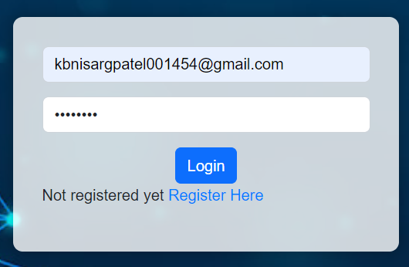
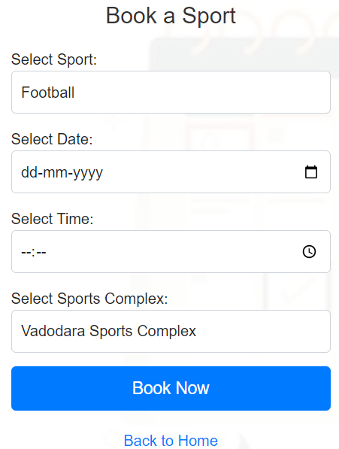
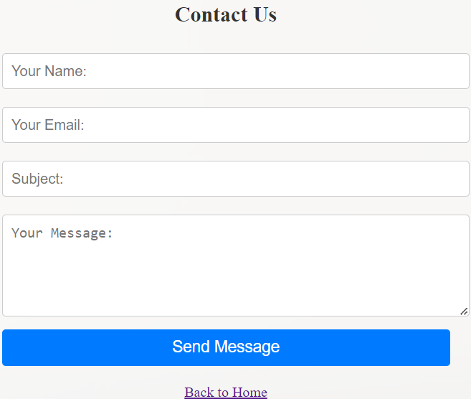
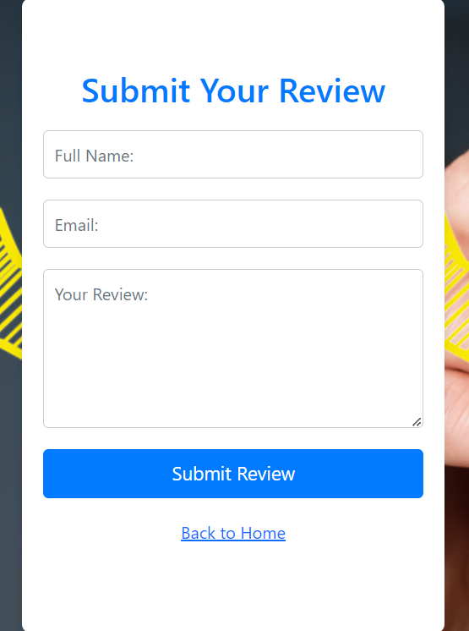
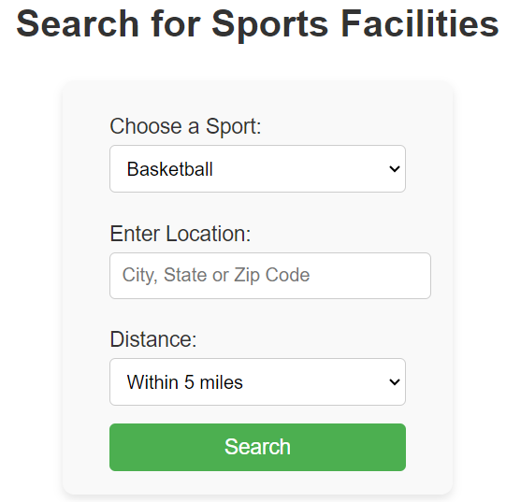
After Logout
After Login
Search Facility
Contact Facility
Review Facility
Booking Facility

Slide 8
TECHNOLOGY STACK
Programming Languages: PHP (for backend development) and HTML/CSS (for frontend development).
Database: MySQL is used to store user data, venue information, bookings, and reviews.
Server: XAMPP is used for local development, combining Apache with MySQL for hosting and database management.

Slide 9
SYSTEM DESIGN
The system uses a three-layer architecture:
Frontend: HTML/CSS for the user interface.
Backend: PHP for server-side scripting.
Database: MySQL to manage user, venue, and booking data.
Flow of Data: When a user searches for a venue, the frontend sends the request to the backend, which retrieves the relevant data from the database and displays it to the user. Similarly, when a booking is made, the backend updates the database and confirms the booking.

Slide 10
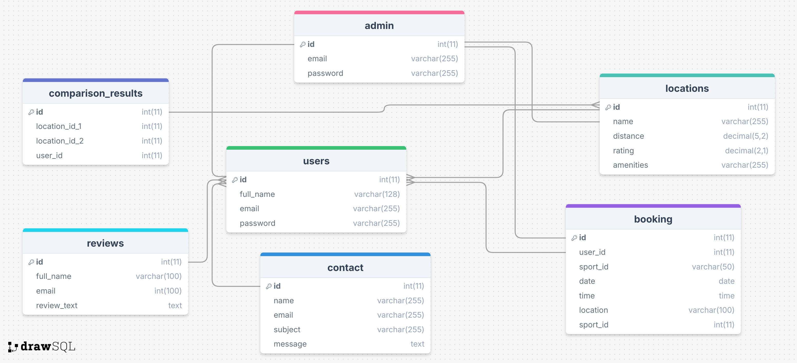
ARCHITECTURAL DESIGN

Slide 11
RESULTS
Key features developed include:
User registration, login, and search functionality.
Advanced filtering and venue comparison options.
Admin dashboard for venue and booking management.

Slide 12
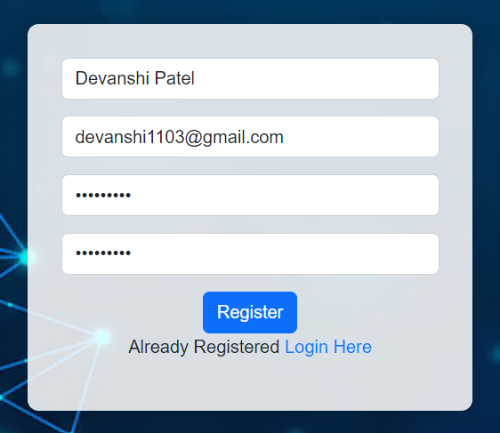
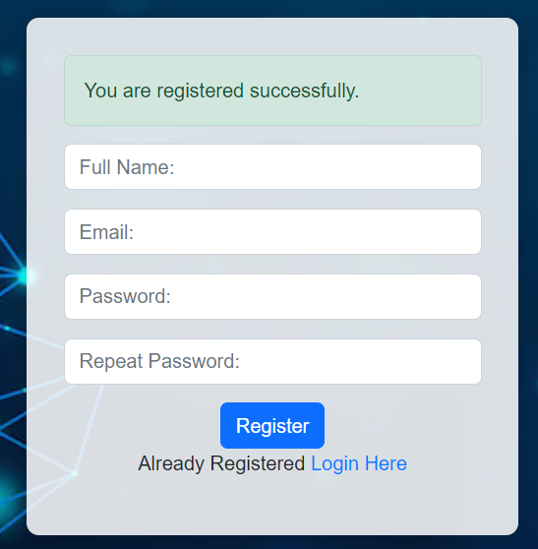
User Registration

Slide 13
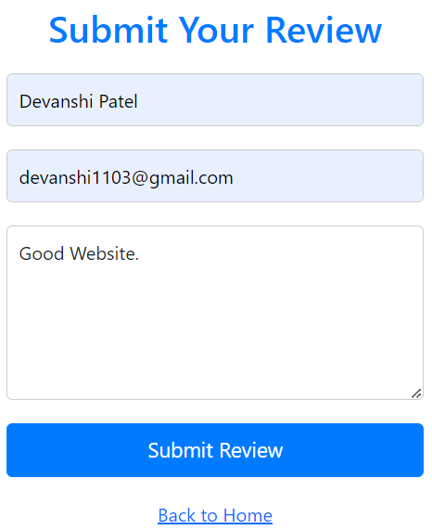
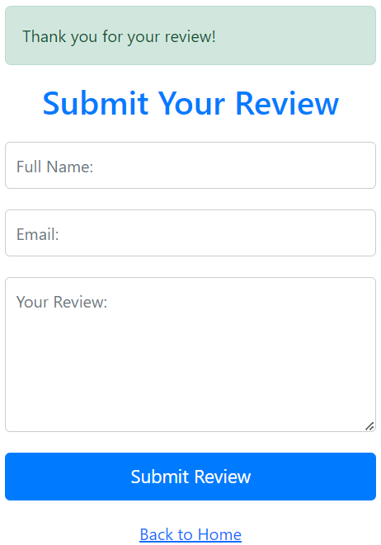
Review Submission

Slide 14
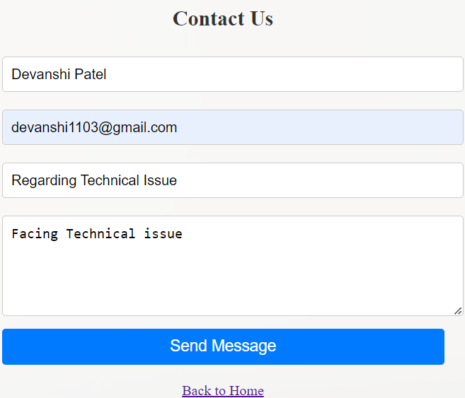
Contact for any Queries

Slide 15
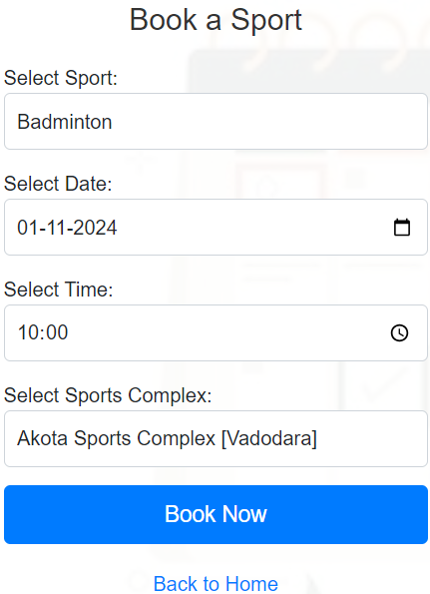
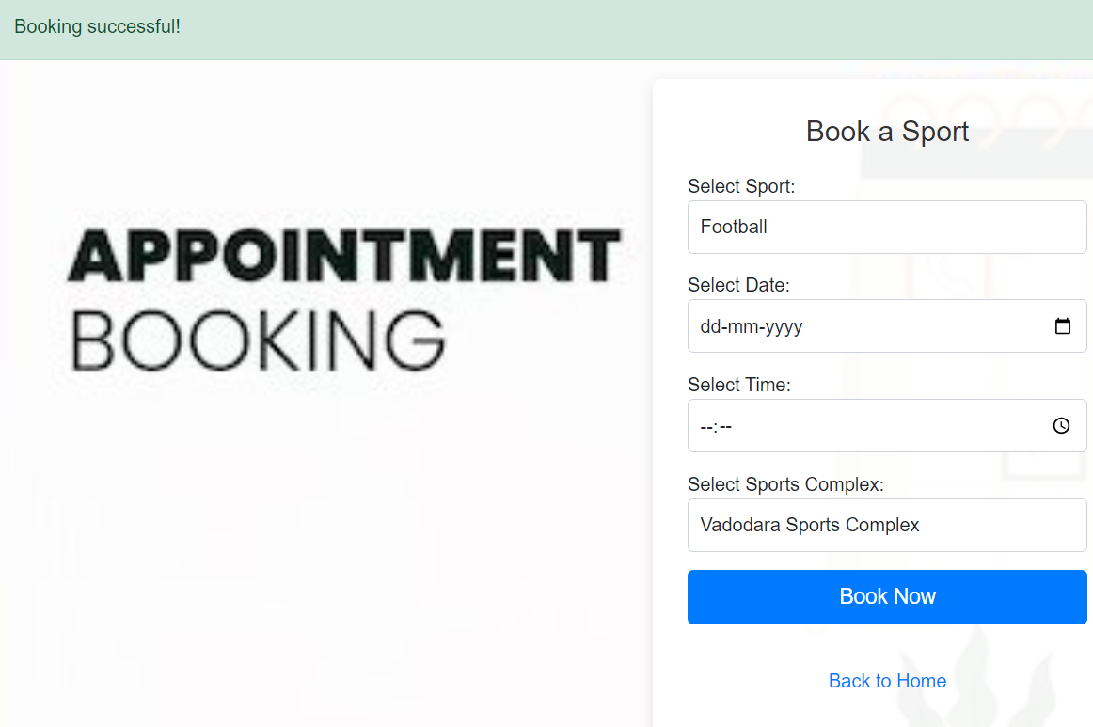
Booking a Slot

Slide 16
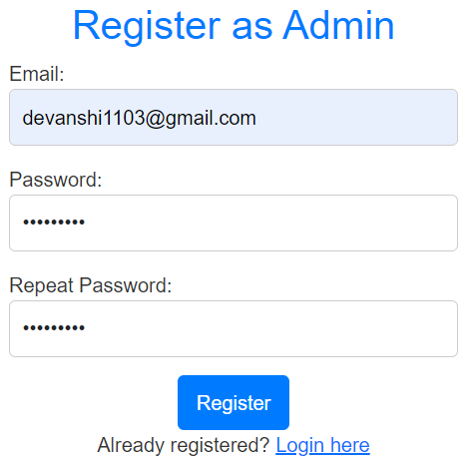
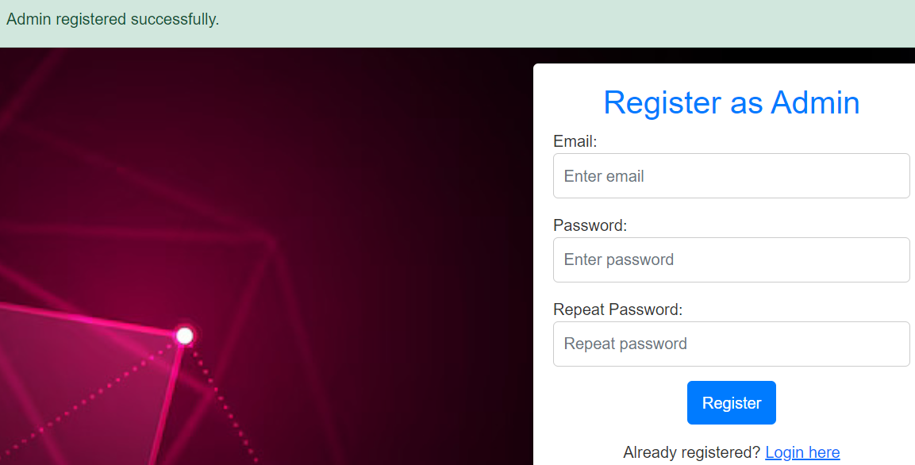
Admin Registration

Slide 17
CHALLENGES FACED
Limited Awareness of Local Facilities: Many people are unaware of the sports facilities available in their vicinity, leading to underutilization of community resources. A centralized website can help raise awareness and improve accessibility.
Fragmented Information Sources: Information on sports complexes is often scattered across different websites, social media, or local notices. This lack of a unified source makes it inconvenient for people to search, especially when comparing locations.
Inefficient Booking Systems: Many sports facilities still rely on traditional booking methods (phone calls or in-person), which can be time-consuming and error-prone. An online system can streamline the process, allowing for real-time booking and availability updates.

Slide 18
CHALLENGES FACED
Overcrowding and Scheduling Conflicts: Without an organized booking platform, some popular facilities become overcrowded, especially during peak times, while others remain unused. A website can help manage bookings and ensure fair access to facilities.
Encouraging Youth and Community Sports Participation: Many young people and local groups find it challenging to locate suitable sports venues, which can discourage participation. A searchable website promotes inclusivity and accessibility, encouraging more people to engage in sports.

Slide 19
CONCLUSION
Technical Skills Development: Building the system strengthens skills in web development, particularly in PHP, HTML, CSS. It also reinforces concepts in database management, user authentication, and session handling.
Problem-Solving and Critical Thinking: Creating a functional and user-friendly platform requires addressing challenges like data management, security, and error handling. These skills improve problem-solving abilities and adaptability.
Project Management: From planning and designing to testing and deploying, working on this project involves organizing tasks, setting timelines, and meeting deadlines—important aspects of effective project management.

Slide 20
FUTURE SCOPE
Integrated Payment and Subscription Plans: Add secure online payment options and create subscription plans or membership features, allowing users to book facilities with discounts, priority access, or monthly passes.
Dynamic Pricing Based on Demand: Introduce dynamic pricing, where facility rental costs vary based on demand, location, and time of booking. This can help with better utilization of off-peak times and facility management.
Virtual Tours and Facility Previews: Enable virtual tours or video previews of facilities, so users can see the location, amenities, and equipment before booking. This can be especially useful for people new to a facility or city.

Slide 21
FUTURE SCOPE
Community and Social Features: Introduce social features such as team formation, event creation, and user profiles. This could enable users to join local sports events, find teammates, or organize group bookings for team sports.
Integration with Wearables and Fitness Apps: Allow integration with wearables and fitness apps, letting users log their activities, track fitness goals, or book facilities based on personal workout needs.
AI-Powered Booking Assistance: Use AI to suggest optimal booking times based on user habits, facility popularity, and time slots available. This can help users find less crowded times or slots that fit their preferences.

Slide 22
REFERENCES
[1.] HTML Tutorial:- https://www.w3schools.com/html
[2.] CSS Tutorial:- https://www.w3schools.com/css/default.asp
[3.] PHP Tutorial:- https://www.w3schools.com/php/default.asp
[4.] Login Form:- https://youtu.be/hQPBeS4xlxg?si=rXZEsvCdbW7mfHv-
[5.] SignUp Form:- https://youtu.be/33stYi03hAs?si=qXX9Uu-bhP6FjbNg
[6.] Creating Database:- https://www.geeksforgeeks.org/sql-create-database
[7.] Connect Login/SignUp Form:- https://youtu.be/MC--T_ULUGE?si=FdjyCL2tv-b4CiKR
[8.] Playo:- https://playo.co/
[9.] BookmySport:- https://bookmysport.co.in/

